Slide 1


Cognitive Services
and Bots
Sasha Rosenbaum
Azure Global Black Belt

Slide 2


Azure is a platform: Think building blocks
Notes:
Kids, dad, caffeine
Powerful because of what is offered
Architecture and design is the key
Competing with single platforms – API management versus apogee, mulesoft

Slide 3
































































Platform Services
Security & Management
Hybrid
Cloud
Media & CDN
Application Platform
Data
Security Center
SQL
Database
Azure AD
Health Monitoring
Media Services
Media Analytics
Content Delivery
Network
Web
Apps
Mobile
Apps
SQL Data
Warehouse
DocumentDB
Portal
AD Privileged
Identity
Management
Azure Active
Directory
Integration
SQL Server
Stretch Database
Redis
Cache
Storage
Tables
Azure
Search
API
Apps
Cloud
Services
Azure AD
B2C
API
Management
BizTalk
Services
Domain Services
Service
Fabric
Notification
Hubs
Intelligence
Multi-Factor
Authentication
Logic
Apps
Service Bus
Functions
Cognitive Services
Bot Framework
Cortana
Backup
Automation
Developer Services
Analytics & IoT
Operational
Analytics
Compute Services
Scheduler
HDInsight
Machine
Learning
Stream Analytics
Container
Service
VM
Scale Sets
Visual Studio
Mobile
Engagement
Import/Export
Key Vault
Data
Catalog
Data Lake
Analytics Service
Data Lake Store
Store/
Marketplace
Batch
RemoteApp
VS Team Services
Xamarin
Azure Site
Recovery
Application
Insights
HockeyApp
IoT Hub
Event
Hubs
Data
Factory
Power BI
Embedded
VM Image Gallery
& VM Depot
Dev/Test Lab
StorSimple
Infrastructure Services
Compute
Storage
Networking
Virtual Machines
Containers
Blob
Queues
Files
Disks
Virtual Network
Load Balancer
DNS
Express
Route
Traffic Manager
VPN Gateway
App
Gateway
Datacenter Infrastructure (32 Regions, 24 Online)
Notes:
Why this Slide:
It shows we have a very broad platform. It about BOTH IaaS and PaaS, that these work together. It shows that we continue to lead in world class IT capabilities and that there’s really nothing missing.
Key Points:
We have already seen how the Azure Platform is IaaS + Pass – but I want you to understand that this is a huge number of capabilities – IT building blocks if you will.
Every one of these blocks you provision anytime, self-service anywhere in the world 24x7. You pay for what you use, you can get more or less anytime and you can fully automate everything…
DON’T spent too much time on this slide – you are going to DEMO (aren’t you!!!)… DON’T go through each block…
Transition to NEXT Slide: Make the build go backwards to show JUST IaaS and then you will go to the demo to show it.

Slide 4



Microsoft Cognitive Services
Give your apps a human side
Vision
From faces to feelings, allow your apps to understand images and video
Speech
Hear and speak to your users by filtering noise, identifying speakers, and understanding intent
Language
Process text and learn how to recognize what users want
Knowledge
Tap into rich knowledge amassed from the web, academia, or your own data
Search
Access billions of web pages, images, videos, and news with the power of Bing APIs
Labs
An early look at emerging Cognitive Services technologies: discover, try & give feedback on new technologies before general availability

Slide 5










Why Microsoft Cognitive Services?
Easy
Flexible
Tested
Roll your own with REST APIs
Simple to add: just a few lines of code required
Integrate into the language and platform of your choice
Breadth of offerings helps you find the right API for your app
Bring your own data for your custom experience
Built by experts in their field from Microsoft Research, Bing, and Azure Machine Learning
Quality documentation, sample code, and community support
GET A KEY
BUILD
Notes:
Why choose these APIs? They work, and it’s easy.
Easy: The APIs are easy to implement because of the simple REST calls. Being REST APIs, there’s a common way to implement and you can get started with all of them for free simply by going to one place, one website, www.microsoft.com/cognitive. (You don’t have to hunt around to different places.)
Flexible: We’ve got a breadth of intelligence and knowledge APIs so developers will be able to find what intelligence feature they need; and importantly, they all work on whatever language, framework, or platform developers choose. So, devs can integrated into their apps—iOS, Android, Windows—using their own tools they know and love (such as python or node.js, etc.).
Tested: Tap into an ever-growing collection of powerful AI algorithms developed by experts. Developers can trust the quality and expertise build into each API by experts in their field from Microsoft’s Research organization, Bing, and Azure machine learning and these capabilities are used across many Microsoft first party products such as Cortana, Bing and Skype.

Slide 6

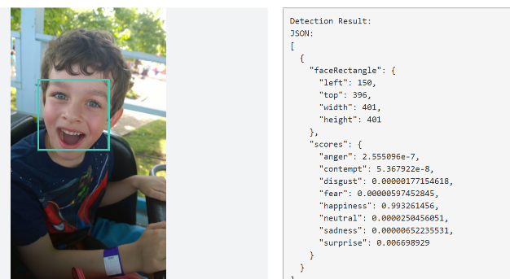
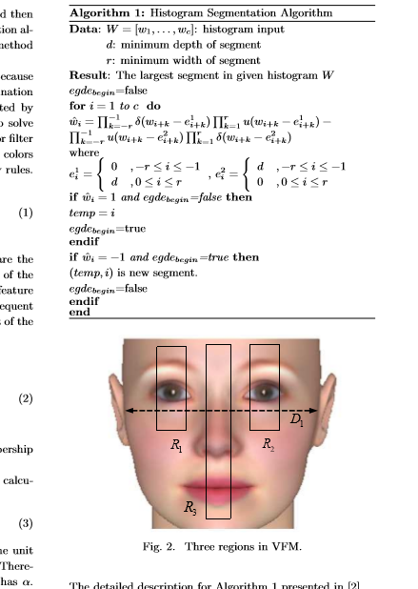
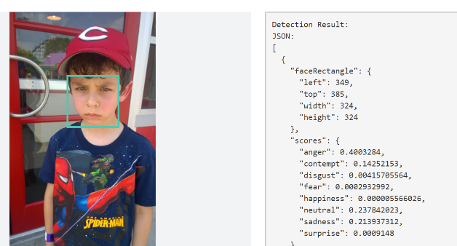
Why are these important?
Or….
What is the algorithm to detect faces and emotions?
Cognitive Services

Slide 7







Vision
Computer Vision API
Face API
Emotion API
Video API
Distill actionable information from images
Detect, identify, analyze, organize, and tag faces in photos
Personalize experiences with emotion recognition
Analyze, edit, and process videos within your app
Content Moderator
Custom Vision Service
Video Indexer
Machine-assisted moderation of text and images, augmented with human review tools
Customizable web service that learns to recognize specific content in imagery
Process and extract smart insights from videos
Notes:
Vision
Computer Vision API: as a free trial on the website microsoft.com/cognitive. There are also SDKs and Samples available on GitHub or through NuGet, Maven, and Cocoapods for select platforms to make development easier. It’s important to note here that it’s not client side running code, but light wrappers around the REST calls to make integration easy.
A photo app would use this as a way to tag user photos and make it easier for users to search through their collections. An assistive app would use this as a way to describe the surroundings to visually-impaired users. Works really well on both indoor or outdoor images; it can recognize common household objects, and it can describe outdoor scenes. However, we did not train on aerial images (say from drones), or on many close ups (so pictures where we zoomed in extremely on the subject won't do well). We also do really well recognizing celebrities (as long as most of the face is visible, and they were facing the camera).
Face API: Some potential uses for this technology include facial login, photo tagging, and home monitoring. Or attribute detection to know age, gender, facial hair, etc.
Emotion API: Build an app that responds to moods. Using facial expressions, this cloud-based API can detect happiness, neutrality, sadness, contempt, anger, disgust, fear, and surprise. The AI understands these emotions based on universal facial expressions, and it functions cross-culturally, so your app will work around the world. Some use cases would be an advertising company wants to test user response to an ad, a tv studio wants to track responses to a pilot.
Video API: It brings Microsoft state of the art video processing algorithms to developers. With Video API, developers can analyze and automatically edit videos, including stabilize videos, create motion thumbnails, track faces, and detect motion. Use cases: For Stabilization: If you have multiple action videos, you can use the stabilization algorithm to make them less shaky and easier to watch. You can also use the stabilization algorithm as a first step in performing other video APIs. For Face Tracking: You can track faces in a video to do A/B testing in a retail setting. You can combine Video API Face Tracking with capabilities in Face API to search through surveillance, crime, or media footage to look for certain person. For Motion Detection: Instead of having to watch long clips of surveillance footage, the API will let you know what time motion occurred and its duration. For Video Thumbnail: Take a long video, such as a keynote presentation, and automatically create a short preview clip of the talk. For Face Tracking: Works best for frontal faces. Currently cannot detect small faces, side or partial faces. For Motion Detection: Detects motion on a stationary background (e.g. fixed camera). Current limitations of the algorithms include night vision videos, semi-transparent objects, and small objects. For Video Thumbnail: Take a long video, such as a keynote presentation, and automatically create a short preview clip of the talk.
Content Moderator: Image moderation - Enhance your ability to detect potentially offensive or unwanted images through machine-learning based classifiers, custom blacklists, and optical character recognition (OCR).
Text moderation - Helps you detect potential profanity in more than 100 languages and match text against your custom lists automatically. Content Moderator also checks for possible personally identifiable information (PII).
Video moderation - Enable the scoring of possible adult content in videos. Video moderation is currently deployed in preview on Azure Media Services.
Human review tool - Humans can effectively augment machine learning models in situations where the prediction confidence warrants assistance or when decisions must be tempered with a real world context. Enjoy visibility, flexibility and control with a human review tool that supervises the results of your algorithms.
Custom Vision Service: an easy-to-use, customizable web service that learns to recognize specific content in imagery, powered by state-of-the-art machine learning neural networks that become smarter with training. You can train it to recognize whatever you choose, whether that be animals, objects, or abstract symbols. This technology could easily apply to retail environments for machine-assisted product identification, or in digital space to automatically help sorting categories of pictures.
Video Indexer : one of the industry’s most comprehensive video AI services. It helps you unlock insights from any video by indexing and enabling you to search spoken audio that is transcribed and translated, sentiment, faces that appeared and objects. With these insights, you can improve discoverability of videos in your applications or increase user engagement by embedding this capability in sites. All of these capabilities are available through a simple set of APIs, ready to use widgets and a management portal.

Slide 8



Speech
Vision
Bing Speech API
Speaker Recognition API
Custom Speech Service
Convert speech to text and back again, and understand its intent
Give your app the ability to know who's talking
Fine-tune speech recognition for anyone, anywhere
Notes:
Speech APIs provide state-of-the-art algorithms to process spoken language powered by Bing. This also includes speech synthesis for a subset of languages supported by speech recognition. With these APIs developers can easily include the ability to add speech driven actions into their applications. In certain cases, the APIs allow for real-time interaction with the user as well. Additional capabilities include voice recognition and speaker identification as well as providing partial transcription, meaning that for supported languages the developer can get partial results before the user has finished speaking. The initial release supports 7 languages.
Bing Speech API: Convert audio to text, understand intent, and convert text back to speech for natural responsiveness. Recognize Voice - Converts spoken audio to text. Support for 18 languages (28 locales); Synthesize Speech - Synthesize audio from Text. Support for 9 languages (17 locales)
We also have SDKs available for Speech.
Custom Speech Service: Custom Speech Service (CRIS) enables you to create customized language models and acoustic models tailored to your application and your users. By uploading speech and/or text data to CRIS that reflects your application and your users, you can create custom models that can be used in conjunction with Microsoft’s existing state-of-the-art speech models. To customize the acoustic model to a particular domain, a collection of speech data is required. This collection consists of a set of audio files of speech data, and a text file of transcriptions of each audio file. The audio data should be representative of the scenario in which you would like to use the recognizer. If you were building an app to search MSDN by voice, it’s likely that terms like “object-oriented” or “namespace” or “dot net” will appear more frequently than in typical voice applications. Customizing the language model will enable the system to learn this. CRIS uses acoustic or language model adaptation to enable the speech recognizer to learn the characteristics of the customer’s data while still getting the benefits of all the data and expertise that went into creating the base models that power the Speech API.
For acoustic model adaptation, the technology is described in this paper: http://research.microsoft.com/pubs/194346/0007893.pdf
Works well when the data is uploaded to CRIS is truly representative of the user population and the expected usage of the application. For language model adaptation, it works best when the data uploaded reflects what people would actually say. Uploading simply a list of new terms is better than nothing but will not be as effective. For acoustic model adaptation, if you want to adapt to elderly speech, you need to upload the speech from many different elderly users, not just one or two. If you upload just one person’s voice, CRIS will learn to do a great job on that voice but will not necessarily learn to generalize to other elderly voices. Similarly, if you want to adapt to a new environment, like a factory, you should upload speech data from many speakers in the factory, not just one.
Speaker Recognition API: Microsoft's state-of-the-art cloud-based speaker recognition algorithms to recognize a human's voice in audio streams. It comprises two components: speaker verification and speaker identification. Speaker Verification can automatically verify and authenticate users from their voice or speech. It is tightly related to authentication scenarios and is often associated with a pass phrase. Hence, we opt for text-dependent approach, which means speakers need to choose a specific pass phrase to use during both enrollment and verification phases. Speaker Identification can automatically identify the person speaking in an audio file given a group of prospective speakers. The input audio is paired against the provided group of speakers, and in case there is a match found, the speaker’s identity is returned. It is text-independent, which means that there are no restrictions on what the speaker says during the enrollment and recognition phases. A use case is biometric authentication using voice.
https://blogs.technet.microsoft.com/machinelearning/2015/12/14/now-available-speaker-video-apis-from-microsoft-project-oxford/
We also have SDKs available for Speaker Reco

Slide 9






Language
Speech
Vision
Bing Spell Check API
Web Language Model API
Linguistic Analysis API
Detect and correct spelling mistakes within your app
Leverage the power of language models trained on web-scale data
Easily parse complex text with language analysis
Language Understanding Intelligent Service
Text Analytics API
Translator
Teach your apps to understand commands from your users
Detect sentiment, key phrases, topics, and language from your text
Easily perform speech and text translation
Notes:
Bing Spell Check API: Microsoft’s state-of-the-art cloud-based spelling algorithms to detect a wide variety of spelling errors and provide accurate suggestions. Using Bing Spell Check, your mobile and PC apps will be powered with state-of-the-art spelling capabilities. Our service is trained on a massive corpus of data gleaned from billions of web pages. There is no need to train your own models. The speller model is updated regularly and incorporates new terms and brands almost as quickly as they appear on the web. This API is available through Microsoft Cognitive Services for customers with low-volume and high-latency jobs. For high-volume and low-latency we have an internal API which may be more suitable. Contact donaldbr directly for more information.
Use cases: 1) Improve the quality of a website's product search 2) provide spell correction for a keyboard app 3) provide spell correction for text fields in an app or web page 4) detect errors in UI text and user data. See https://blogs.msdn.microsoft.com/msr_er/2010/12/15/building-a-better-speller-bing-and-microsoft-research-offer-prizes-for-best-search-engine-spelling-alteration-services/ The speller is exceptional at common spelling errors with low edit-distance (such as febuary->February) but a lot of other spellers are good at that as well. We Do a very good job with word breaking, proper names in context (try "director stephen spielberg") and fictional character names, just a few examples. Areas that are a challenge are capitalization (we don't know what to do with "March" for example, even with context) and consistency (there are times when we will flag a word only intermittently based on the context).
Web Language Model API: Web Language API indexes the web and Bing queries to allow users to calculate the probabilities of natural language expressions and estimate a list of most likely words to follow an existing sequence of words. Use this API to insert spaces into a string of words without spaces, like a hashtag or URL. Use this API to rerank machine translation/speech recognition candidate sentences based on probability of the sentence.
Use this API for academic research. http://research.microsoft.com/apps/pubs/default.aspx?id=130762
We also have SDKs available for WebLM
Linguistic Analysis API: The Linguistic Analysis API helps you gain insights from text. Given a natural language parse, it’s easy to identify the concepts and entities (noun phrases), actions (verbs and verb phrases), descriptive words, and more. The processed text can provide useful features for classification tasks such as sentiment analysis.
We also have SDKs available for Linguistic Analysis.
Language Understanding Intelligent Service (LUIS) allows developers to build a model that understands natural language and commands tailored to their application. Example: You can say “turn down the thermostat in the living room,” send it to a LUIS model, and instead of just returning the text that represents what was said, LUIS will return: the action is “turn down,” the location is “living room,” and the target is “thermostat.” LUIS allows developers to iteratively build on these models and take speech or text input and return a structured representation of what the person said. Not only that but by build LUIS will help developers create and train smart conversational bot (Intercom or Slack) with a single button. LUIS will also offer action fulfillment capabilities by simple integration with webhooks. LUIS works pretty well it comes to intents. For the entities, the learning curve is slower especially when the number of entities increases. LUIS only supports 20 intents & 10 entities yet by build each entities can have up to 10 children.
Translator API: Translate speech and text
Language Detection Automatically detect the language of any text string.
Translation Add speech translation, for any of the 9 supported languages, and text translation, for any of the 60 supported languages, to your app.
Text to speech (TTS) Send text strings and receive back the audio version in one of the 19 supported languages.
Custom translation system Build a custom translation system, using as little as 1,000 parallel sentences or start out simply by providing a dictionary of company specific words.
Collaborative translation network Improve translations by creating a specific user group that provides suggestions to improve the translations.
Text Analytics API: At the time of publication, this data was not available. Please email Rebecca Duffy, reduffy@microsoft.com, if you would like more information.

Slide 10

Linguistic analysis
Analysis tools for natural language processing Access to part-of-speech tagging and parsing, identifying concepts, and actions

Slide 11
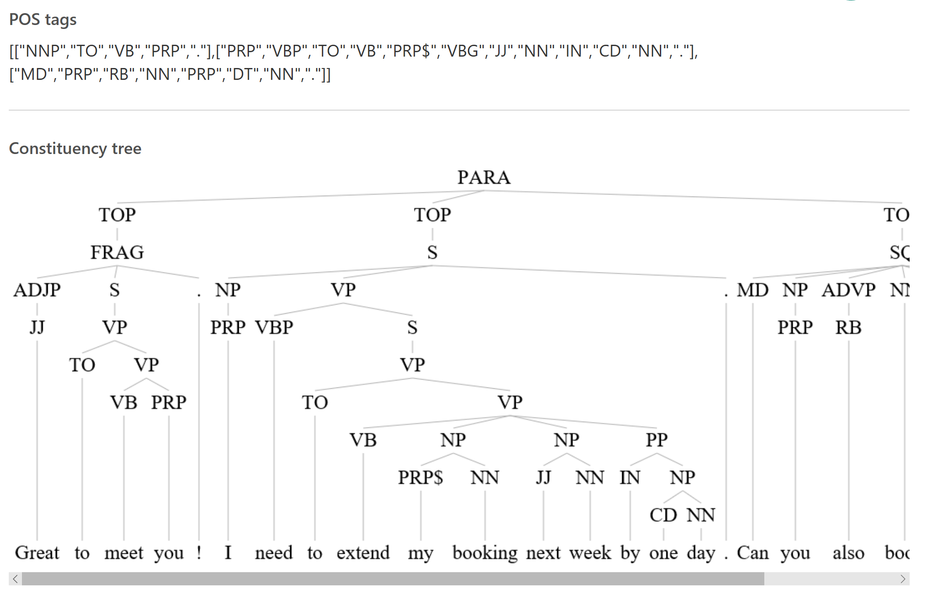
Linguistic Analysis
“Great to meet you ! I need to extend my booking next week by one day. Can you also book me a car?”
Natural language processing tools that identify the structure of text.
Sentence separation and tokenization
Part-of-speech tagging
Constituency parsing
English only
Great to meet you !
I need to extend my booking next week by one day .
Can you also book me a car ?

Slide 12

Text analytics
Sentiment analysis (EN, FR, PT, ES) Understand if a record has positive or negative sentiment
Key phrase extraction (EN, DE, JA, ES) Extract key phrases from a piece of text, and retrieve topics
Topic detection (EN) Use clustering techniques to identify the trending topics on a large set of text records
Language detection Identify the language, 120 supported languages

Slide 13





Knowledge
Speech
Vision
Academic Knowledge API
Knowledge Exploration Service
Entity Linking Service
Explore relationships among academic papers, journals, and authors
Add interactive search over structured data to your project
Contextually extend knowledge of people, locations, and events
Recommendations API
Custom Decision Service
Provide personalized product recommendations for your customers
Create custom experiences with adaptive, contextual decision-making
Notes:
Academic Knowledge : The Academic Knowledge API enable developers to interpret user queries for academic intent and retrieve rich entity information about research papers, authors, journals, conferences, and universities from the Microsoft Academic Graph (MAG). 1. Developers can use this API to build search features such as the knowledge-based query auto-suggest and search results at http://academic.microsoft.com. 2. Universities can retrieve analytics data about their researchers' publications, topics, and venues. 3. Conference organizers can analyze the citation patterns of their conference papers. 4. Data scientists and computer science researchers can develop new ranking and analysis approaches over a large heterogeneous network.
A publication about our approach can be found here: http://research.microsoft.com/apps/pubs/default.aspx?id=246609 The underlying data graph (Microsoft Academic Graph) is constructed over discovered academic papers on the web. The data is largely unstructured, of variable quality, and ambiguous. We are constantly working to improve this data quality and to correctly aggregate the multiple instances of authors, papers, etc. into a single representative entity in the graph.
Knowledge Exploration Service : Enable interactive search experience over structured data via natural language. Indexes customer's structured data (BYOD) with support for prefix completion. Generates annotated interpretations/completions of natural language queries. Publishers/libraries can use this to create interactive search over their publications similar to academic.microsoft.com. Merchants can create interactive search experience to help users find and discover products. Data owners can create systems that answer natural language user questions. It works best when the structured data is clean and the natural language structure is simple and predictable. Otherwise, customers will have to invest a bit of work to generate the structured data and author the grammar. We are working on future components to simplify both authoring aspects.
Entity Linking : Given a specific paragraph of text within a document, the Entity Linking will recognize and identify each separate entity based on the context and linking the entity to wikipedia. Use cases: A news agency would use this to analysis their news article to create relations between articles, a news agency would use this to generate tags for article and make recommendation for reader, a company would use this to track the PR articles mentioned it and product comments to track customer feedback. We also have SDKs available for Entity Linking.
Recommendations API: Learn from previous transactions to predict which items are more likely to be of interest to or purchased by your customers. Built using Azure Machine Learning, the Recommendations engine uses customer data—either past customer activity you’ve uploaded or data collected directly from your digital store—to offer recommended items for your customers and increase conversion rates.
Custom Decision Service: a service that helps you create intelligent systems with a cloud-based contextual decision-making API that adapts with experience. Custom Decision service uses reinforcement learning in a new approach for personalizing content; it’s able to plug into your application and helps to make decisions in real time as it automatically adapts to optimize your metrics over time

Slide 14


The Recommendations API allows Allrecipes.com to harness billions of user-shared experiences to deliver highly personalized recipe solutions that answer busy families most pressing question, ‘What’s for dinner tonight?’
We are able to do this with minimal investment due to the proven capabilities of the Cortana Analytics platform. This helps us further realize our vision of providing highly personalized cooking inspiration for home cooks.
John Keane CTO, Allrecipes.com

Slide 15
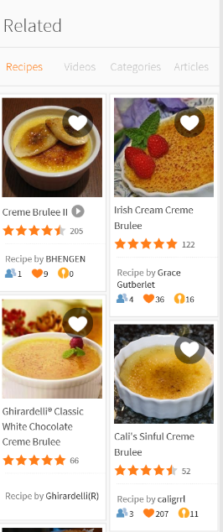
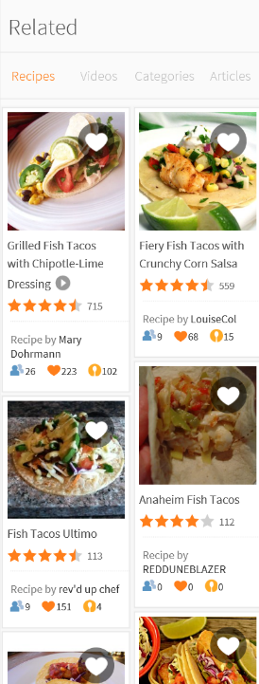
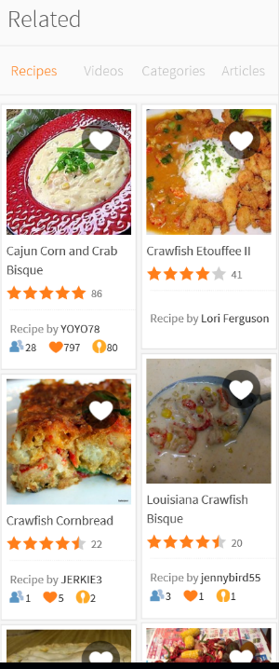
Recommendations API

Slide 16






Search
Speech
Vision
Bing Web Search API
Bing Image Search API
Bing Video Search API
Connect powerful search to your apps
Bring advanced image and metadata search to your app
Trending videos, detailed metadata, and rich results
Bing News Search API
Bing Autosuggest API
Bing Custom Search
Link your users to robust and timely news searches
Give your app intelligent autosuggest options for searches
Create a highly-customized web search experience
Notes:
The Search APIs provide access to the search technology that power Bing.com and a long list of 1st-party (Office, Cortana, Xbox, Edge) and 3rd-party (AOL, Apple, Amazon, Yahoo etc.) partners. In total, we have 4 Search APIs for web, image, video and news search. In addition we provide access to our Autosuggest (type-ahead) and Spell Check services.
Bing Web Search API: is the main Search API. With one programmatic call, the user can get back relevant webpage, image, video, and news results. It's equivalent to searching in the web vertical in bing.com. The Search APIs provide the power of the Bing Search engine to developers. You get access to many of the latest and greatest capabilities the bing.com site has to offer, in the form of an API. It's the same architecture stack so it's a powerful way to bring the knowledge and intelligence of the search engine to your own experience. The API is built directly on top of the entire Bing stack- you get the quality, relevance, performance and continuous improvements that the rest of the site gets. Similar to Bing.com- tail queries, or obscure terms may have limited results. We're always working to improve the edge cases though and API users will benefit from that.
Bing Image Search API: Help users scour the web for images. Results include thumbnails, full image URLs, publishing website info, image metadata, and more. Try out the demo.
Bing Video Search API: Find videos across the web. Results provide useful metadata including creator, encoding format, video length, view count, and more
Bing News Search API: Search the web for news articles. Results include details like authoritative image of the news article, related news and categories, provider info, article URL, and date added
Bing Autosuggest API: Help users complete queries faster by adding intelligent type-ahead capabilities to your app or website. Empower users to type less and do more with automated and complete search suggestions.
Bing Custom Search: lets you create a highly-customized web search experience, which delivers better and more relevant results from your targeted web space. Featuring a straightforward User Interface, Bing Custom Search enables you to create your own web search service without a line of code. Specify the slices of the web that you want to draw from and explore site suggestions to intelligently expand the scope of your search domain. Bing Custom Search can empower businesses of any size, hobbyists and entrepreneurs to design and deploy web search applications for any possible scenario.

Slide 17

Microsoft Cognitive Services Labs
Speech
Vision
An early look at emerging Cognitive Services technologies: discover, try, and give feedback on new technologies before general availability
Project Prague
Project Cuzco
Project Johannesburg
Gesture based controls
Event associated with Wikipedia
Route logistics
Project Nanjing
Project Abu Dhabi
Project Wollongong
Isochrones calculations
Distance matrices
Score location attractiveness
Notes:
Labs provides developers with an early look at emerging Cognitive Services technologies. Early adopters who do not need market-ready technology can discover, try and provide feedback on new Cognitive Services technologies before they are generally available.
Project Prague. SDK to incorporate gesture-based controls into your apps. Quickly define and implement customized hand gestures, creating a more natural user experience. Limited private preview availability at launch.
Project Cuzco. API to help developers find events associated with Wikipedia entities. Begin with a Wikipedia entity, and receive a list of related events organized by time.
Project Johannesburg. API to calculate route logistics for with deeper location intelligence to account for specific enterprise requirements. IE: weight, height length, hazardous materials, etc.
Project Nanjing. API to calculate isochrones - time and distance-based recommendations for enterprise route optimization.
Project Abu Dhabi. API to create distance matrices, enabling you to calculate a histogram of travel times, and serve as stepping stone for enterprise route optimization.
Project Wollongong. API to help ‘score’ the attractiveness of a location, based on how many of a particular amenity are within a specific distance. Ex: restaurants, parks, transit stops.

Slide 18






What is the Bot Framework?
What?
Tools for building REST Web Sites
Services to enrich
Mechanisms for receive events
Data to debug and analyze
Customer’s
Business Logic & Data
Bot Connector
Why?
Implements standard protocols
Modeling conversations is hard. Tools help!
UI across multiple canvases is hard. Cards rock!
Language Understanding is hard
Common and well understood patterns
C#
BOT BUILDER
Bot Controls
Skype
Bing
Web Chat
Goals
Start Simple. Add Complexity. No dead-ends.
Bot adapts to the user, based on context
Composable and intelligent controls to manage complexity
LUIS
Form Filling
QnA
Skype for Business
Cortana
Direct Line
Query over database via Azure Search
3rd Party

Slide 19


Why a Bot?
TYPE
TALK
TAP
Bot Builder
Cortana
Facebook Messenger
Skype
Platform Services
Intelligent Tools
Bing

Slide 20










Bot framework surface area
Channels
Bot Connector Service
Bot builder
Core platform
AI and resources
Notes:
Bot Builder SDK also provides a powerful system for building dialogs that encapsulate conversational logic, built-in prompts for simple things such as Yes/No, strings, numbers, and enumerations, built-in support for powerful AI frameworks such as LUIS, and more.
The Bot Builder provides an SDK, libraries, samples, and tools to help you build and debug bots. Portal, VS, Emulator, Testing

Slide 21
Bot Connector Service
Registration, routing from channels, authentication.
Runs in Azure.
Bot Code
Bot Connector Service
http://dev.botframework.com
Notes:
Bot Connector Service – communicate with channels over REST and JSON over HTTPs
Authentication with JWT tokens
Communicates by passing Activity object between bot and channel (user)
Bot state service – data on a user/conversation (only in connector service)
C# / Node SDKs, can build your own

Slide 22




Channels
User interacts with interface they are comfortable with. Agnostic to the bot code. Channels are independent
Bot Code

Slide 23



Bot Builder
Hosting options
App Service Plan
Bot Code
Consumption (Azure Functions)
Your bot code. Tools for conversational modeling, bot memory, and integration of business logic.
Anywhere else with public endpoint
(Service Fabric, K8s Container, On-Prem)

Slide 24




AI and Resources
LUIS
Machine Learning
QNA Maker
Cognitive Services

Slide 25



An x-ray of a typical bot
Conversation Canvas/Channels
Your bot code goes here
(Azure options)
Web Chat
Bot Connector Service
Email
Message input <> output
Authorization
State Management
Facebook
Bot web service
GroupMe
Your bot code
Bot Builder SDK
Kik
Skype
Bot Builder SDK
API, SDK calls
Slack
+ Microsoft Cognitive Services
Telegram
Other services, APIs,
Databases, Azure Machine Learning, Azure Search, etc…
Natural Language
Translation
Vision/Face
Emotion
Twilio (SMS)
…
Direct Line…
Speech
Entity Extraction
Search
Knowledge API
…
…
…

Slide 26






Bot Business Scenarios
Appointments, initial triage, test result retrieval
In-cab assistant & communication
Medical
Transportation
HR data management, organizational information, Delve
Guest relations, booking assistance
Staff Productivity
Hospitality
Password reset, service desk case initialization, IT staff automation
Automated responses, call center IRC, call center staff knowledge base
IT Help Desk
Customer Service

Slide 27

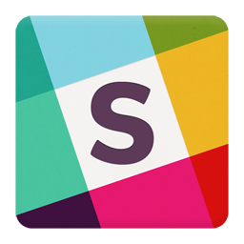
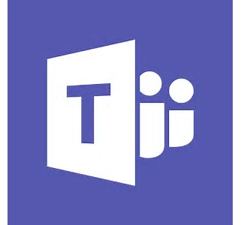


Publish anywhere using Bot Framework
Write once…
Register and manage your bot
Build with the Bot Builder SDK
Test with the Bot Emulator
Deploy to Azure or other cloud service
Access open source code and samples
… Publish everywhere
Text/SMS
Skype
Slack
Teams
Web Chat
Office 365 email
Facebook Messenger
Kik
Cortana
Direct line

Slide 28
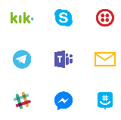

Sample Architecture
Application Insights - Telemetry
Inbound Channels
Cognitive Services
Speech To Text
LUIS
Sentiment
Bot
Company APIs
Bot Connector
Dialog Experiences
QNA Builder
Azure Bot Service
Interaction storage Machine Learning
Power BI

Slide 29

BOT Demonstrations:
Bot Service on Azure
Channels
Visual Studio Template
Dialogs
QNA Maker

Slide 30
Microsoft Cognitive Services
Give your apps a human side
Vision
Computer Vision | Content Moderator | Emotion | Face | Video | Video Indexer | Custom Vision Service
Speech
Bing Speech | Custom Speech Service | Speaker Recognition
Language
Bing Spell Check | Language Understanding | Linguistic Analysis | Text Analytics | Translator Text & Speech | Web Language Model
Knowledge
Academic Knowledge | Entity Linking | Knowledge Exploration | Recommendations | QnA Maker | Custom Decision Service
Search
Bing Autosuggest | Bing Image Search | Bing News Search | Bing Video Search | Bing Web Search | Bing Custom Search
Labs
Project Prague | Project Cuzco | Project Johannesburg | Project Nanjing | Project Abu Dhabi | Project Wollongong

Slide 31
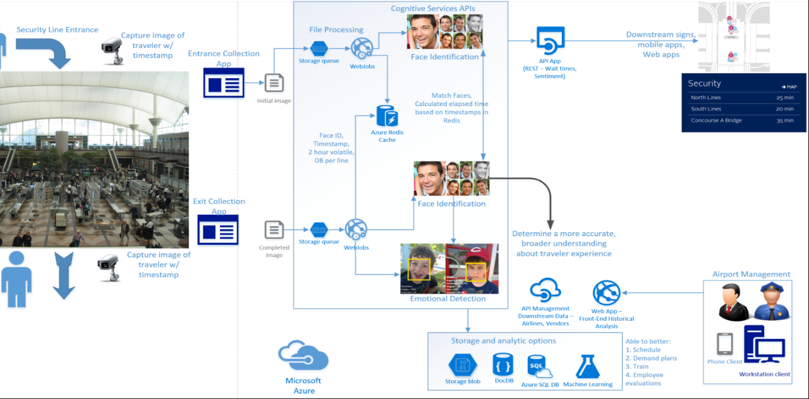

Slide 32
Questions?

Slide 33
Thank you!

